Slide 1

Liquid State Machine with Memristive Microwires
Jack Kendall – Rain Neuromorphics

Slide 2

Motivation
Why hasn’t neuromorphics succeeded at the same level as deep learning?
Lack of good neuromorphic algorithms.
Poor scalability of fully-connected layers.

Slide 3
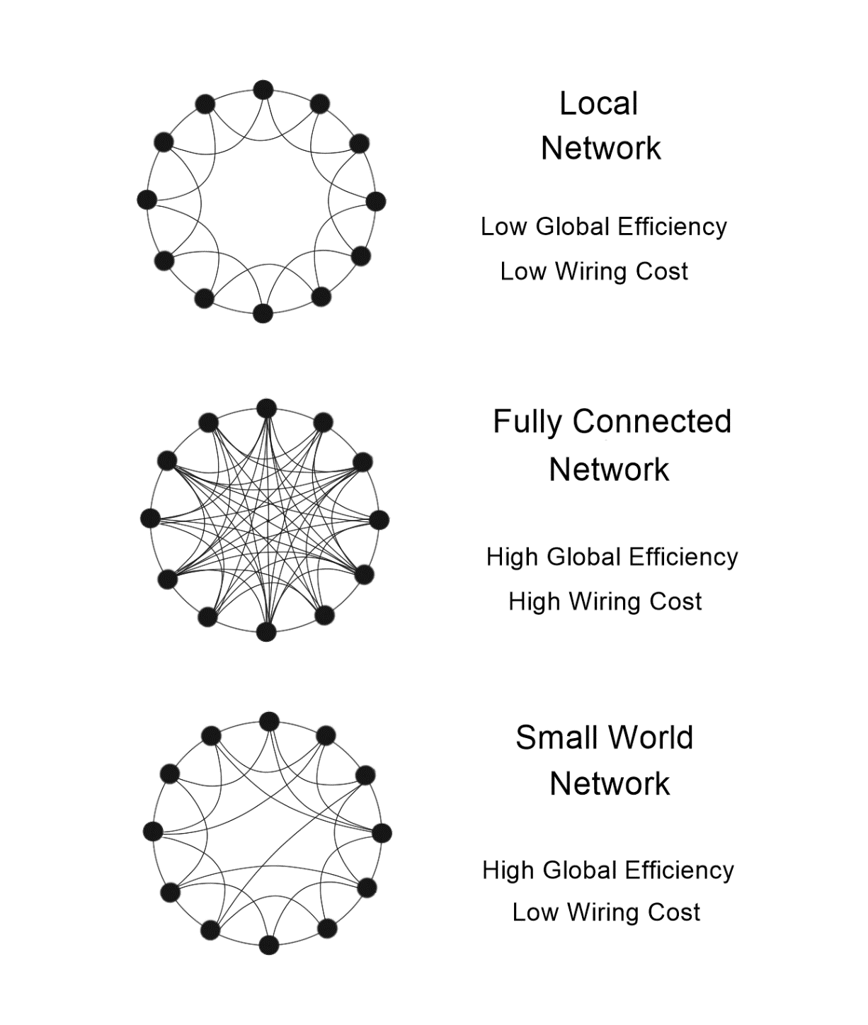
Sparsity is critical for scalable neuromorphic hardware
The brain uses primarily two forms of sparsity: Small-World and Scale-Free.
These forms of sparsity minimize wiring cost while maximizing network efficiency.
They allow the wiring density to scale at the same rate as the neuron density.
But what plays the mischief with this masterly.

Slide 4
Natural sparsity can be achieved with random memristive nanowires
OUR AGENDA
The wires mimic 1-D structures of biological neurons: axons and dendrites.
Memristive coating forms artificial synapses at interface with silicon neurons.

Slide 5
Memristive Nanowire Neural Network (MN³)
Excellent scaling characteristics: ~ 1 billion trainable parameters per cm² [1].
Intrinsic small-world connectivity [1].
Supports both reservoir computing [2] and deep learning [3] algorithms.
But what plays the mischief with this masterly.
[1] R. Pantone, J. Kendall, and J. Nino, “Memristive Nanowires Exhibit Small-World Connectivity,” Neural Networks (in press).
[2] L. Suarez, J. Kendall, and J. Nino, “Evaluation of the Computational Capabilities of a Memristive Random Network (MN3) under the context of Reservoir Computing Mathematical and Computational Analysis,” Neural Networks (in press).
[3] J. Kendall and J. Nino, Deep Learning in Bipartite Memristive Networks. U.S. Patent Application No. 15/985,212. Unpublished (filing date 05/21/2018).

Slide 6
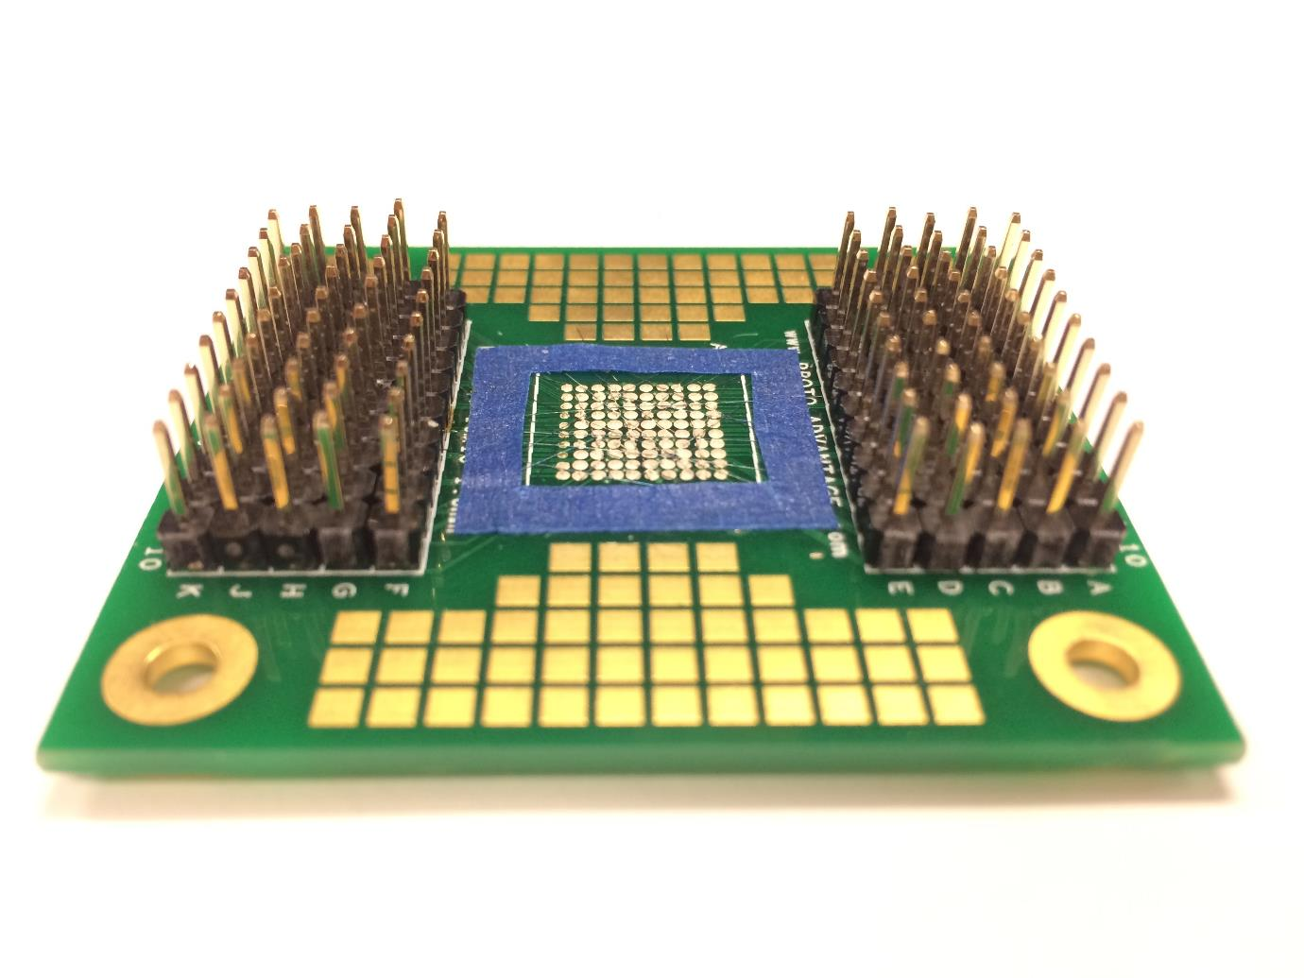
MN³ Proof of Concept
100 electrode ball-grid array.
22 μm diameter tungsten wires (W).
Wires oxidized at 400 °C to form a memristive coating tungsten oxide (WO_{x}).

Slide 7
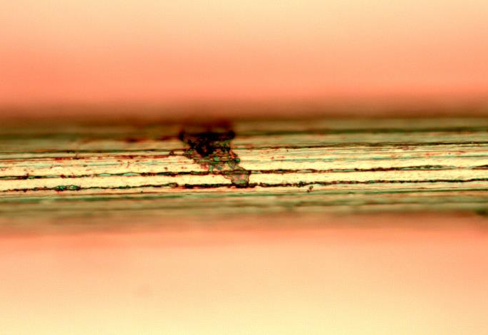
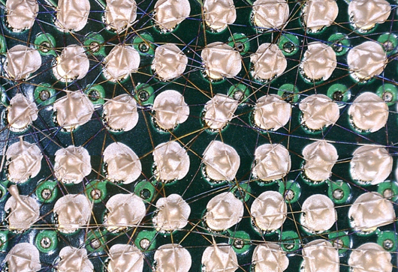
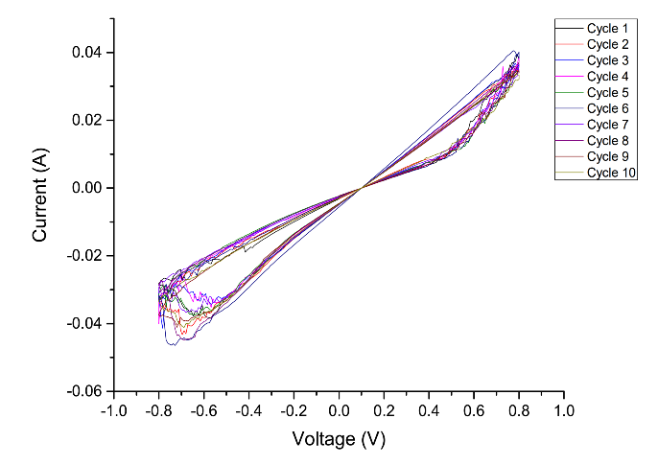
MN³ Hardware Details
Single W-WO_{x} Wire
MN³ with Ag Electrodes
W/WO_{x}/Ag I-V Curve
A thin layer of tungsten oxide is thermally grown on the 22 μm diameter wires.
Wires are randomly deposited on an electrode array and connected to the array using silver paste.
Resulting I-V curves for the tungsten wires with Ag top electrode.

Slide 8
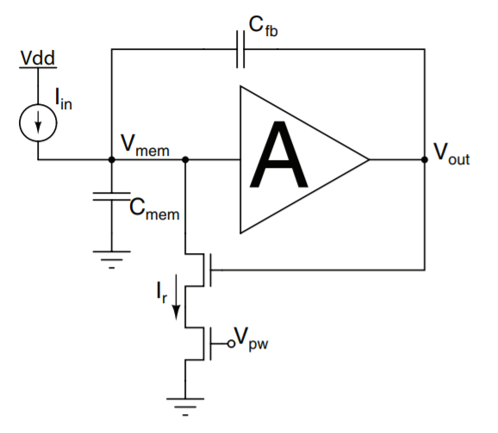
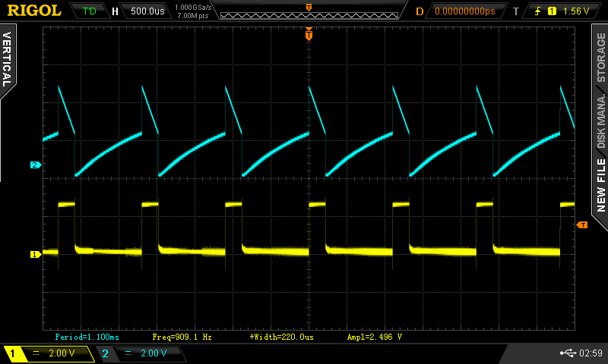
Analog Spiking Neurons
Axon Hillock model (Mead 1989).
Built and tested with discrete components.
Coupled with MN³ memristor network through single-transistor synapses.
But what plays the mischief with this masterly.

Slide 9
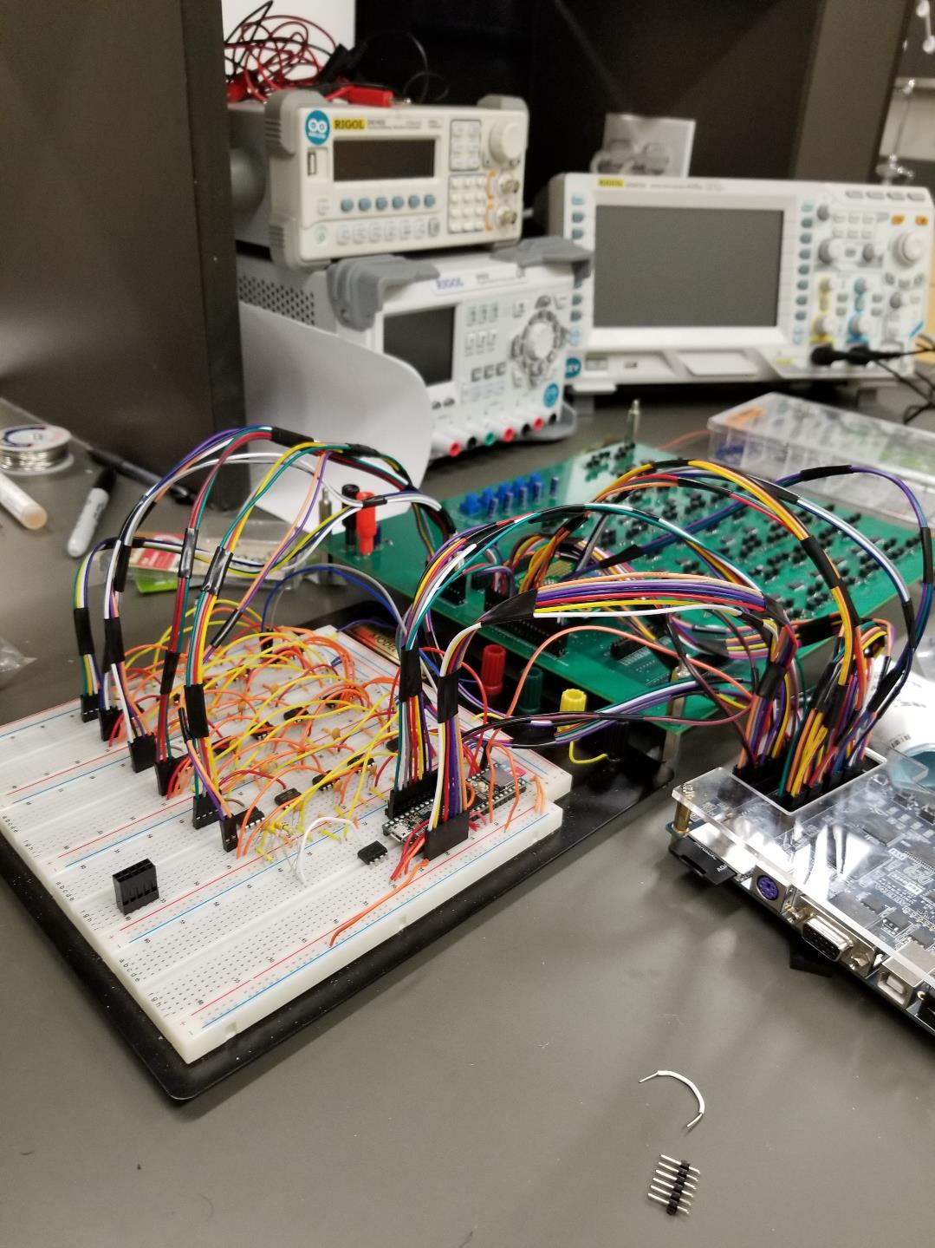
MN³-Based Liquid State Machine
OUR AGENDA
Custom designed PCB with 40 axon-hillock spiking neurons.
10 input neurons with variable tuning curves.
Teensy 3.6 microcontroller and Altera FPGA for I/O and spike detection.

Slide 10
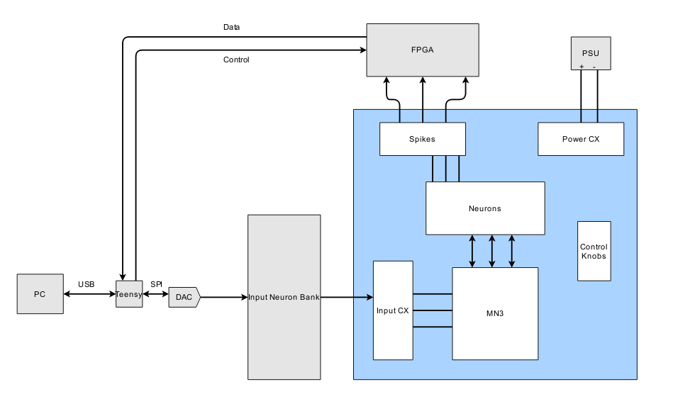
Liquid State Machine System Overview

Slide 11
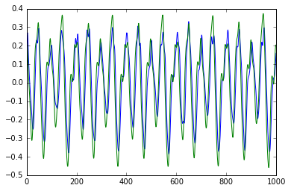
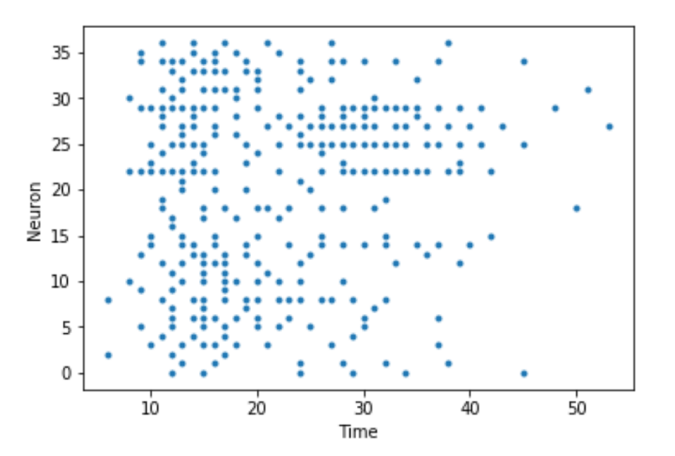
Liquid State Machine
Results
Mackey-Glass Predictions
Spoken Digits Spike Raster
Actual Data: Green Curve
Prediction: Blue Curve (overlaid)
Achieves 94% accuracy on an isolated subset of the TIDIGITS spoken digits dataset.

Slide 12
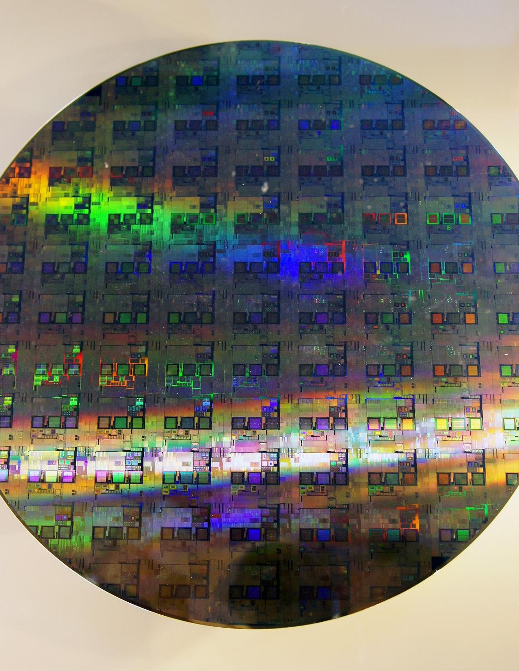
Next Steps and Future Work
Successfully trained deep MN³ models via novel backpropagation algorithm.
Sparse Vector-Matrix Multiply (VMM) A.I. Accelerator.
First 5,000 neuron VLSI chip planned for 2019 (TSMC 180 nm).
But what plays the mischief with this masterly.

